Slide 1
Mini-Project
Evolution of the
Value of the main
Cryptocurrencies
OOP + Tkinter + Open Data + JSON
Flavien BOULEAU
Bastien OLLIVER
terminale spécialité NSI : 2021-2022

Slide 2

SUMMARY
► Project Presentation
► API
► Graph
► Fonctionality
► Final Result
► Tasks Distribution
► Code
► Possible Improvement(s)

Slide 3
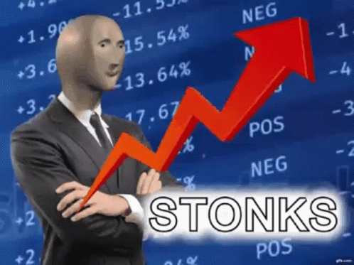

CONTEXT
Cryptocurrency → numeric currency that we mine, sell, or buy with a computer
⇒ no need bank
⇒ the price is not based on a stable value and is not impacted by inflation
⇒ started 14 years ago but recently became known
⇒ most known : BTC (Bitcoin) and ETH (Ethereum)

Slide 4


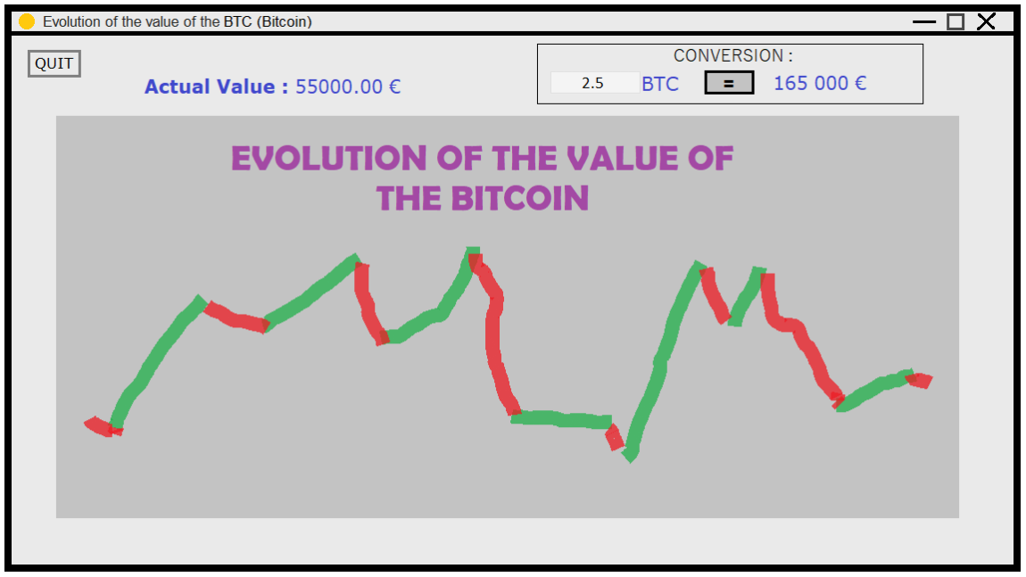

ORIGINAL IDEA
Evolution of the Value of the main Cryptocurrencies
Realize an interface to visualize the Bitcoin curve and its current price
Offer an easy tool for conversions

Slide 5

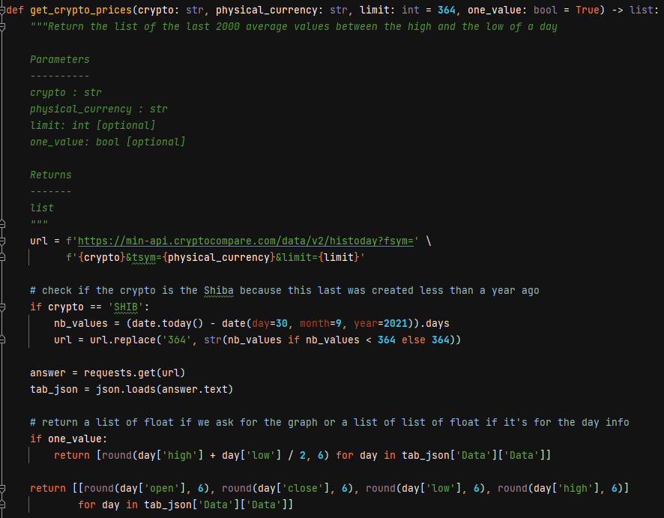
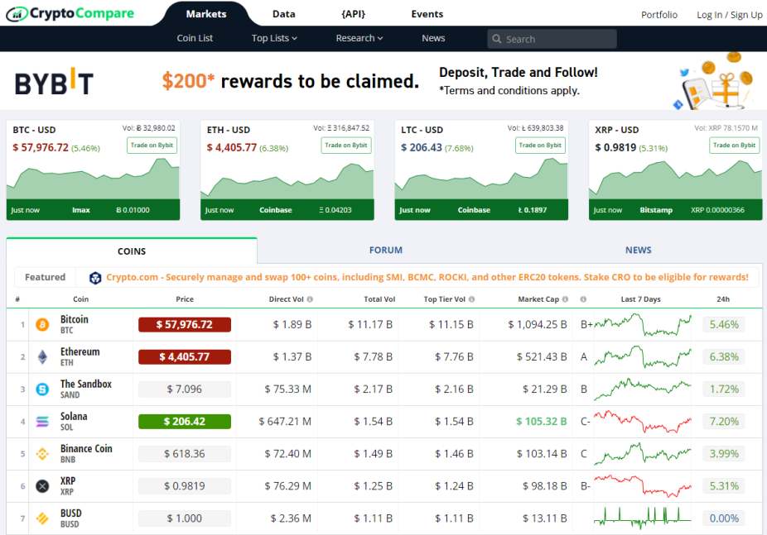
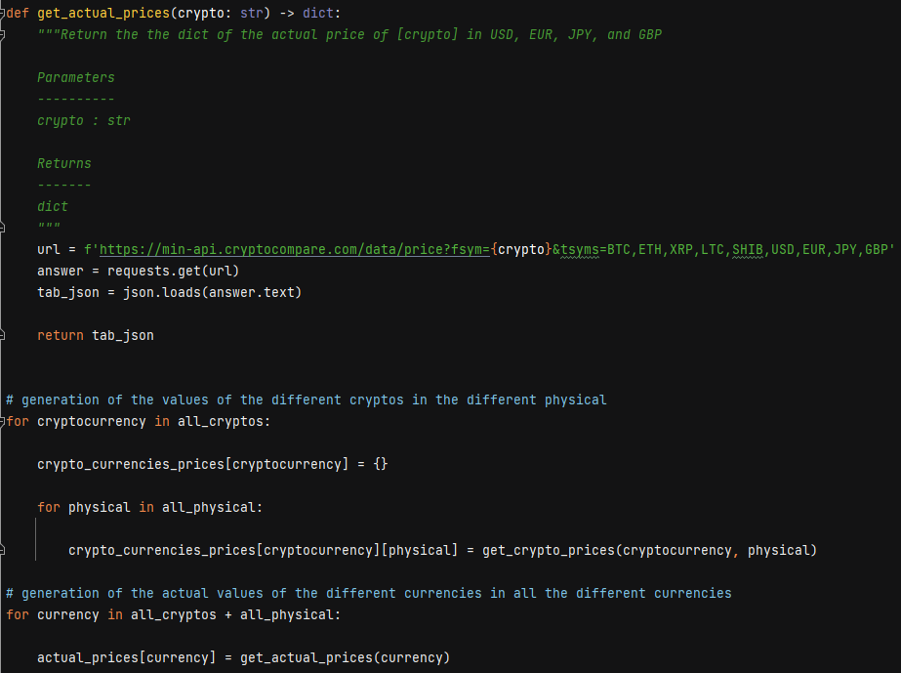
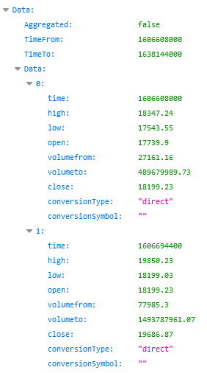
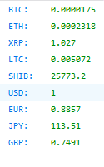
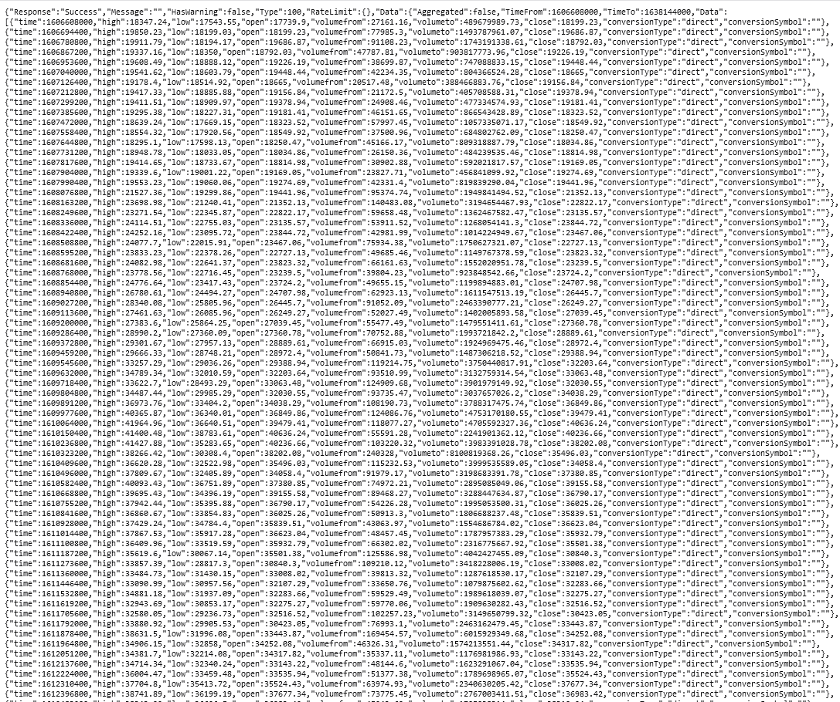
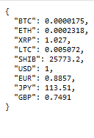
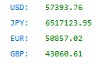
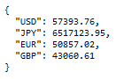
API
Evolution of the Value of the main Cryptocurrencies
https://min-api.cryptocompare.com/data/price?fsym=USD&tsyms=BTC,ETH,XRP,LTC,SHIB,USD,EUR,JPY,GBP
https://min-api.cryptocompare.com/data/v2/histoday?fsym={cryptocurrency}&tsym={physical_currency}&limit=365
https://min-api.cryptocompare.com/data/price?fsym=BTC&tsyms=USD,JPY,EUR,GBP

Slide 6
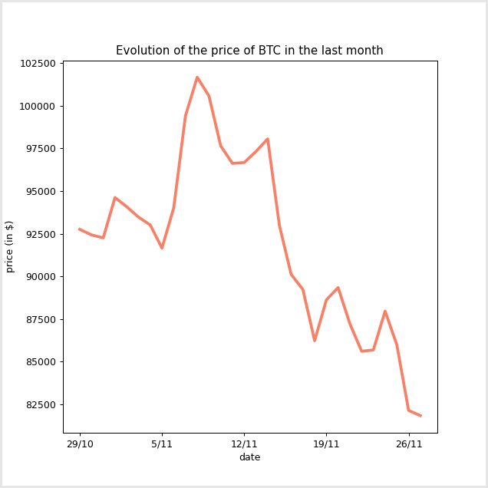
GRAPH

Slide 7


GRAPH
" ascent – descent "
" gain – loss "
" full "
" USD – dollar "
" EUR - euro"
" JPY - yen "
" GBP – pound sterling "
" BTC – Bitcoin "
" ETH – Ethereum "
" XRP - Ripple "
" LTC – Litecoin "
" SHIB – Shiba "
" 1 year "
" 1 month "
" 1 week "

Slide 8
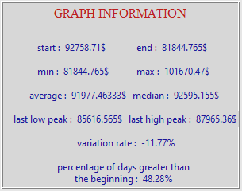
GRAPH INFORMATION
Evolution of the Value of the main Cryptocurrencies

Slide 9
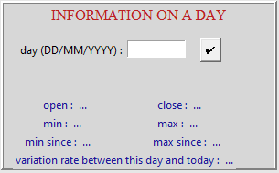
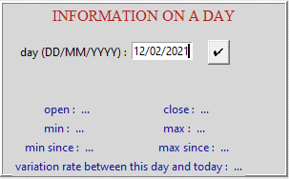
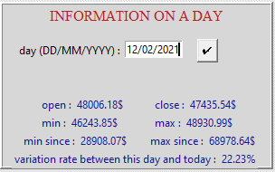
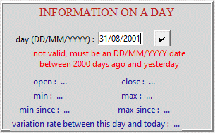
DAY INFORMATION
Evolution of the Value of the main Cryptocurrencies

Slide 10
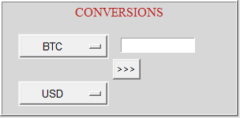
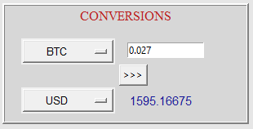
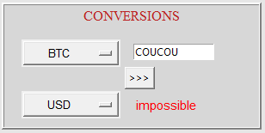
CONVERSION
Evolution of the Value of the main Cryptocurrencies

Slide 11
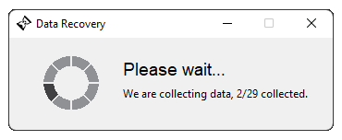
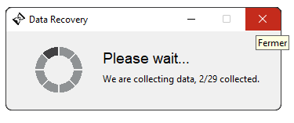
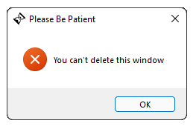
LOADING WINDOW
Evolution of the Value of the main Cryptocurrencies

Slide 12
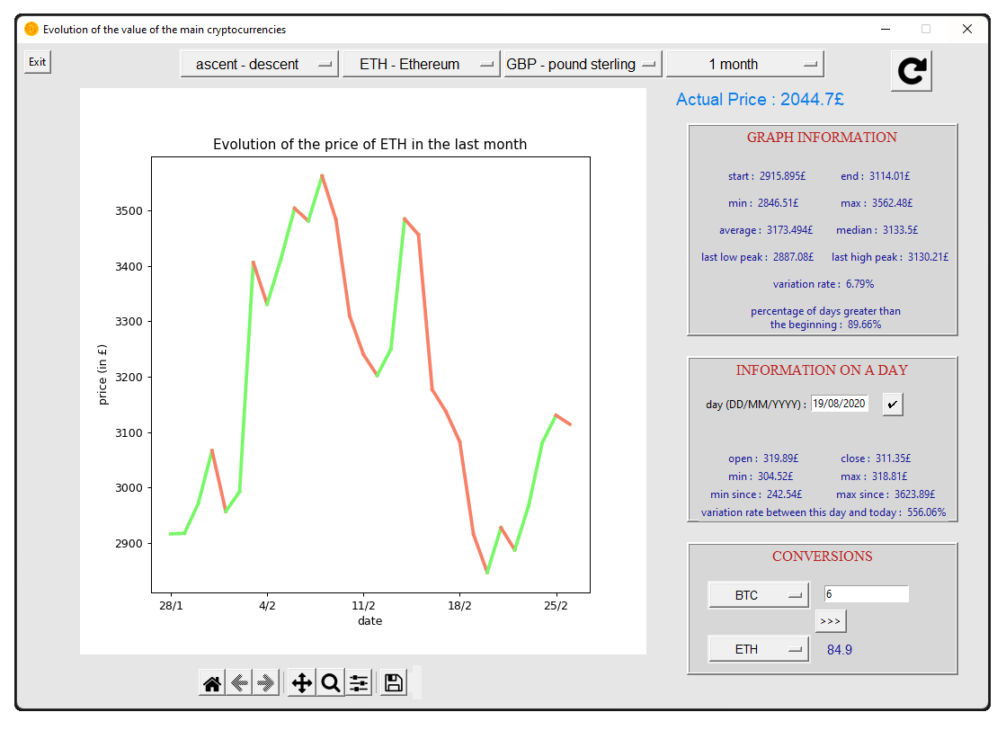
FINAL RESULT
Evolution of the Value of the main Cryptocurrencies

Slide 13
TASKS DISTRIBUTION
Evolution of the Value of the main Cryptocurrencies
FLAVIEN | BASTIEN
Interface creation | Find the API
Graph | Crypto Currency prices
Scrolling menus | Date verification
Graph information | Find peaks
Information on a day | Large part of the slideshow
Conversions
Loading window
Finalization of the slideshow | Finalization of the slideshow

Slide 14
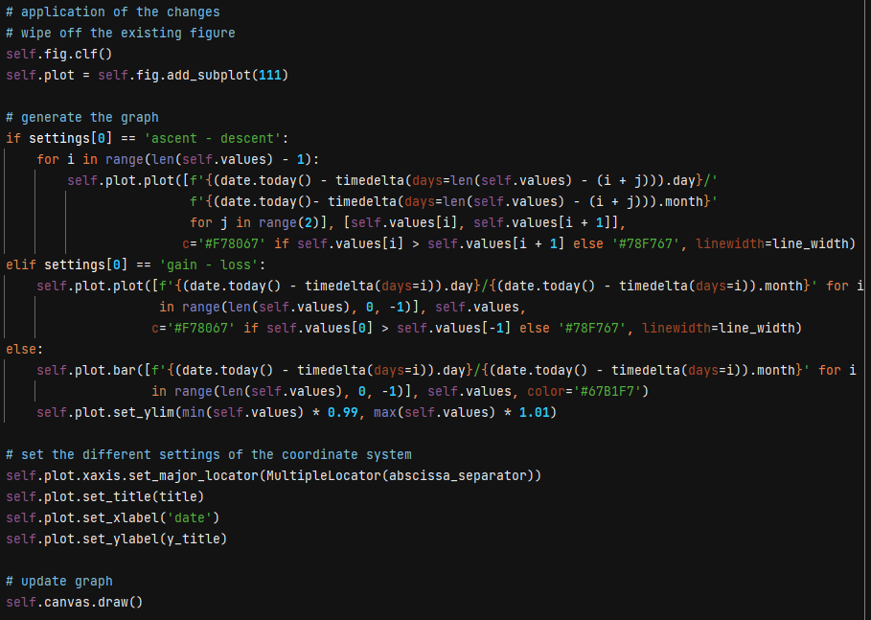
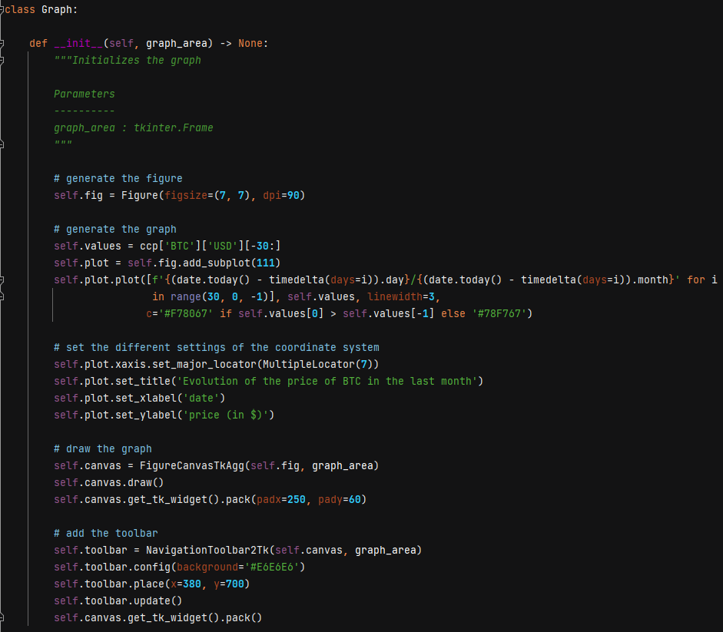
CODE GRAPH
Evolution of the Value of the main Cryptocurrencies

Slide 15
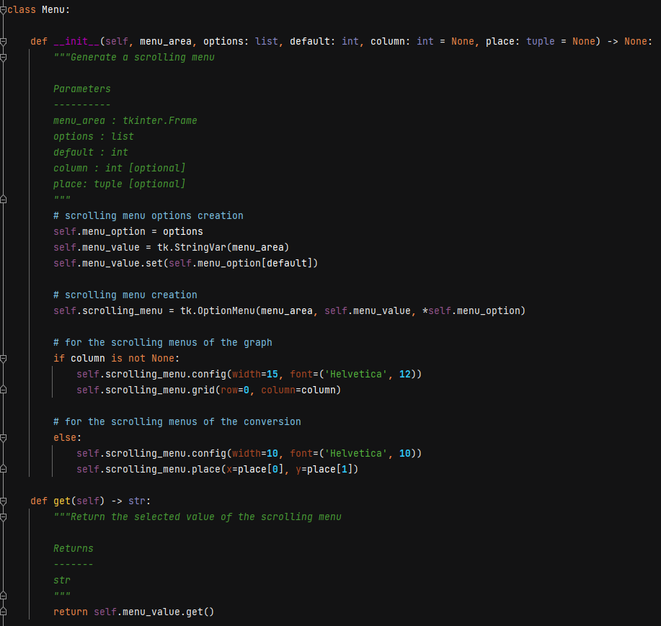
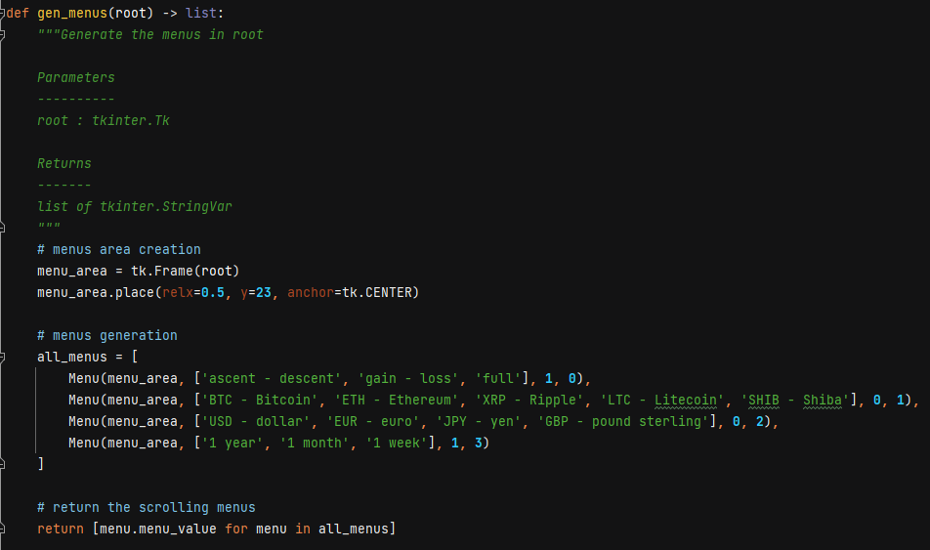
CODE SCROLLING MENUS
Evolution of the Value of the main Cryptocurrencies

Slide 16
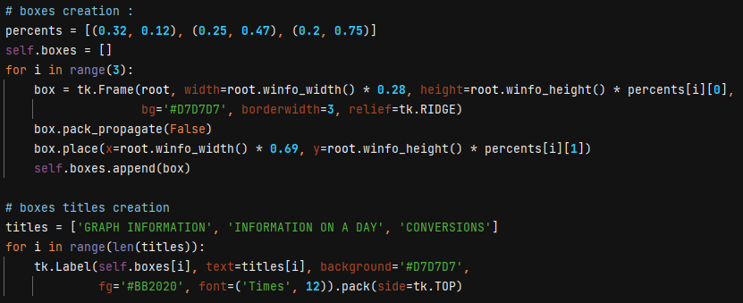
CODE LOWER RIGHT AREA
Evolution of the Value of the main Cryptocurrencies

Slide 17
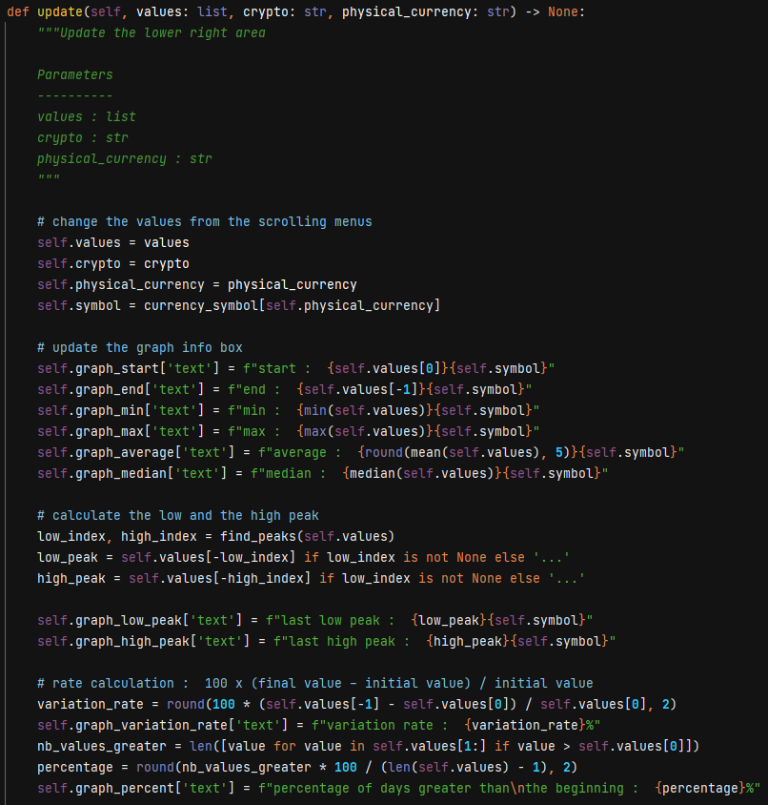
CODE GRAPH INFORMATION
Evolution of the Value of the main Cryptocurrencies

Slide 18
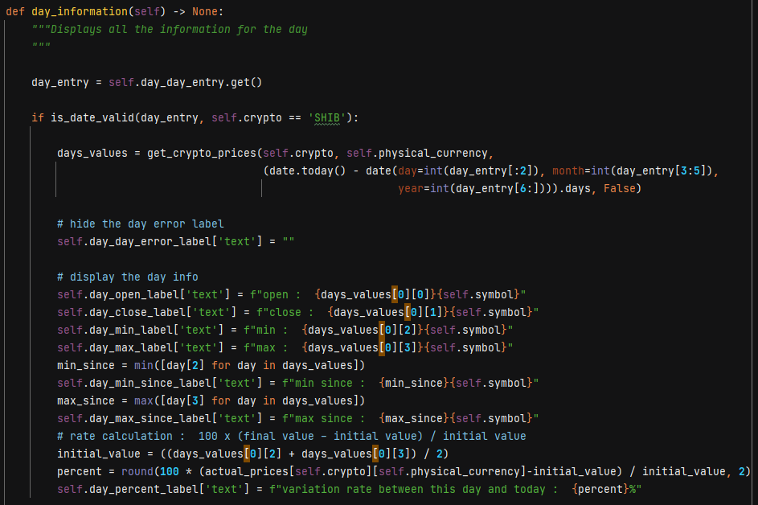
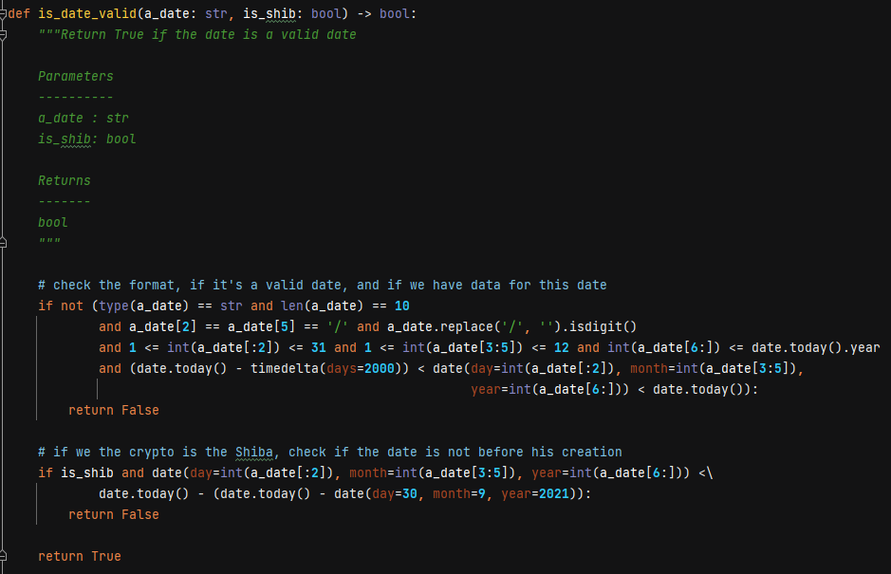
CODE DAY INFORMATION
Evolution of the Value of the main Cryptocurrencies

Slide 19
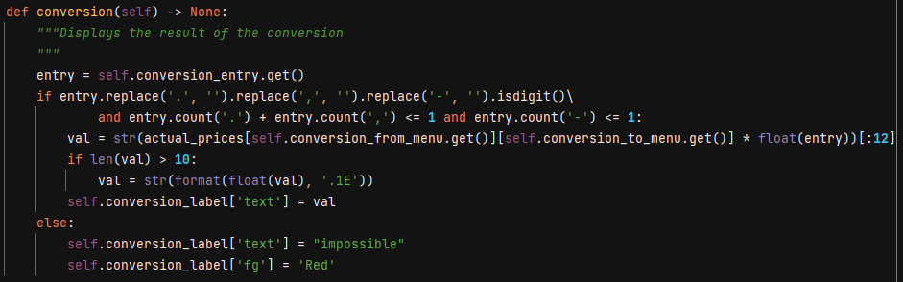
CODE CONVERSION
Evolution of the Value of the main Cryptocurrencies

Slide 20
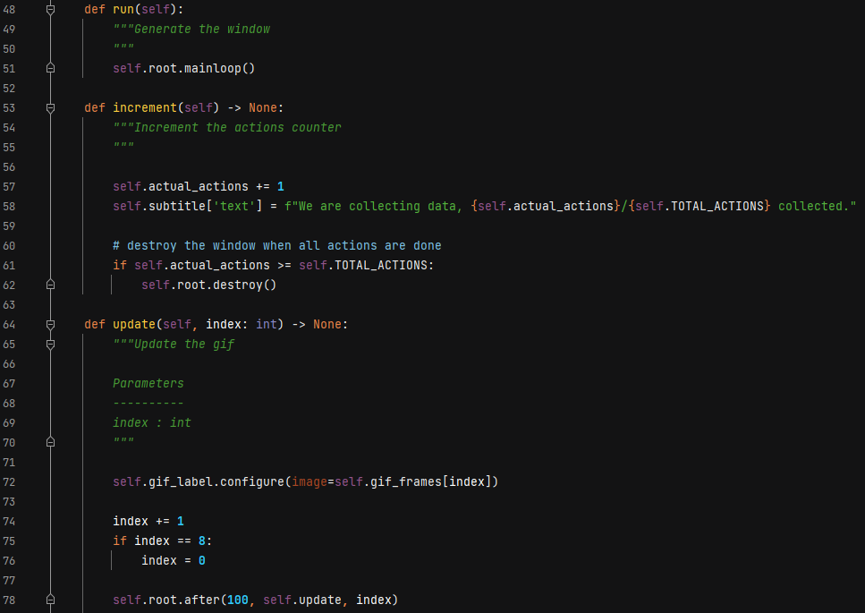
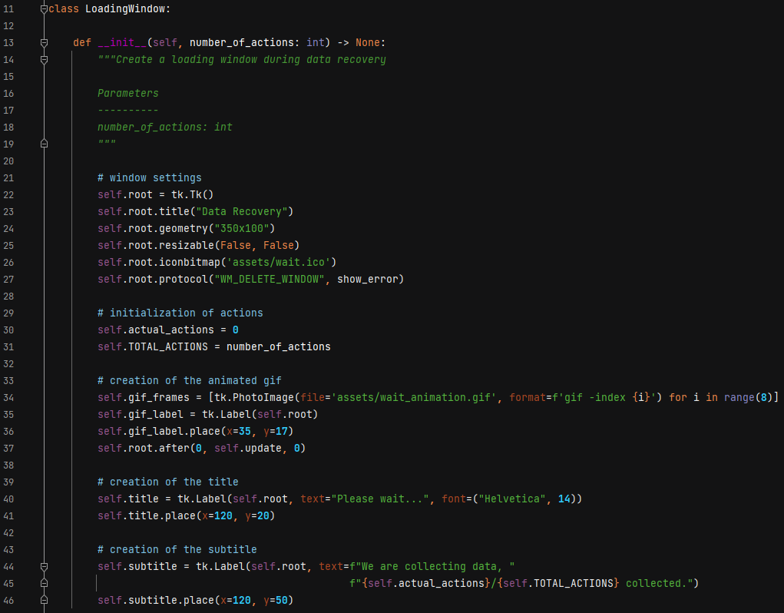
CODE LOADING WINDOW
Evolution of the Value of the main Cryptocurrencies

Slide 21
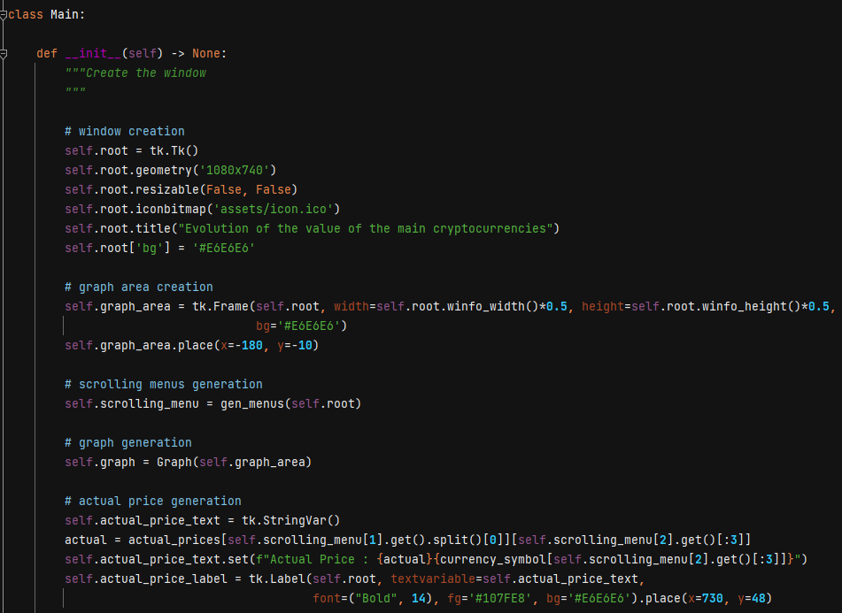
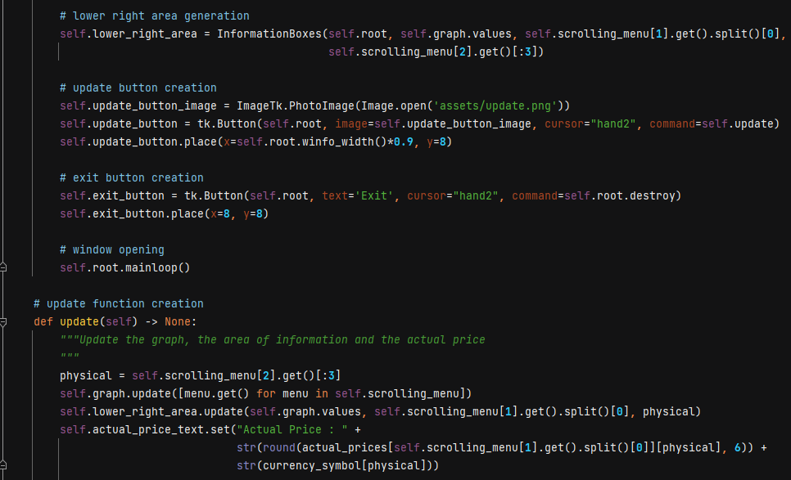
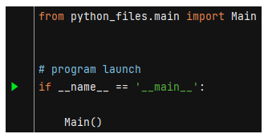
CODE MAIN FILE
Evolution of the Value of the main Cryptocurrencies

Slide 22
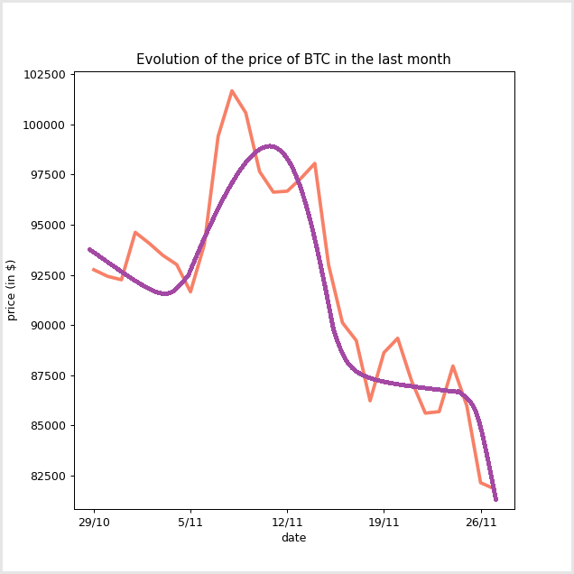
POSSIBLE IMPROVEMENT(S)
Evolution of the Value of the main Cryptocurrencies
⋄ add a purple curve to average the evolution
⋄ it's up to you to tell us: any ideas ?

Slide 23
THANKS
Evolution of the Value of the main Cryptocurrencies
Questions ?

